Slide 1
Confidence Intervals and Hypothesis Testing
Part 2
BUAN/MECO 6312
Dr. Moran Blueshtein
University of Texas - Dallas

Slide 2
Hypothesis Tests

Slide 3
Hypothesis Tests
Hypothesis testing procedures compare a conjecture (a null hypothesis) that we have about a population to the information contained in a sample of data.

Slide 4
Hypothesis Tests
The Null Hypothesis
A null hypothesis is the belief we will maintain until we are convinced by the sample evidence that it is not true, in which case we reject the null hypothesis
The null hypothesis is stated as H₀ : β_{k} = c, where c is a constant, and is an important value in the context of a specific regression model

Slide 5
Hypothesis Tests
The Alternative Hypothesis
Paired with every null hypothesis is a logical alternative hypothesis H₁ that we will accept if the null hypothesis is rejected.
Possible Alternative hypotheses are:
H₁ : β_{k} > c
H₁ : β_{k} < c
H₁ : β_{k} ≠ c

Slide 6
Hypothesis Tests
The Test Statistic
To decide whether to reject the null hypothesis or not to reject it, we perform a test:
The primary test statistic is:
If the null hypothesis H₀ : = c is true, then we can substitute c for and it follows that:
If the null hypothesis is not true, then the t-statistic does not have a t-distribution with N-2 degrees of freedom

Slide 7
Hypothesis Tests
The Rejection Region
We reject the null hypothesis if the test statistic falls in the “Rejection Region”
The “Rejection Region” consists of values that are unlikely and that have low probability of occurring when the null hypothesis is true
The chain of logic is:
‘‘If a value of the test statistic is obtained that falls in a region of low probability, then it is unlikely that the test statistic has the assumed distribution, and thus it is unlikely that the null hypothesis is true’’

Slide 8
Hypothesis Tests
The Rejection Region
The rejection region depends on the level of significance of the test α - is usually chosen to be 0.01, 0.05 or 0.10.

Slide 9
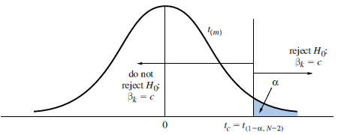
Rejection Regions for Specific Alternatives
Rejection region for a one-tail test of H₀:β_{k} = c against H₁:β_{k} > c
One-tail Test with Alternative “Greater Than”
When testing the null hypothesis H₀:β_{k} = c against the alternative hypothesis H₁:β_{k} > c, reject the null hypothesis and accept the alternative hypothesis if
t ≥ t_{(1-α;N-2)}

Slide 10
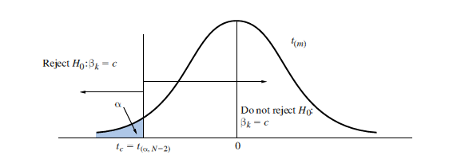
Rejection Regions for Specific Alternatives
Rejection region for a one-tail test of H₀:β_{k} = c against H₁:β_{k} < c
One-tail Test with Alternative “Less Than”
When testing the null hypothesis H₀:β_{k} = c against the alternative hypothesis H₁:β_{k} < c, reject the null hypothesis and accept the alternative hypothesis if
t ≤ t_{(α;N-2)}

Slide 11
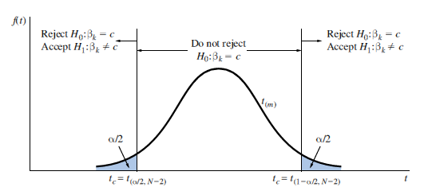
Rejection Regions for Specific Alternatives
Rejection region for a test of H₀:β_{k} = c against H₁:β_{k} ≠ c
Two-tail Test with Alternative “Not Equal To”
When testing the null hypothesis H₀:β_{k} = c against the alternative hypothesis H₁:β_{k} ≠ c, reject the null hypothesis and accept the alternative hypothesis if
t ≤ t_{(α/2;N-2)} or t ≥ t_{(1-α/2;N-2)}

Slide 12
Hypothesis Tests
The Rejection Region
We could commit two types of error
If we reject the null hypothesis when it is true, then we commit what is called a Type 1 error
The level of significance of a test is the probability of committing a Type I error
P(Type I error) = α
If we do not reject a null hypothesis that is false, then we have committed a Type II error
It is possible we don’t reject the null hypothesis although it is wrong!

Slide 13
Hypothesis Tests
Conclusion
Avoid saying that you ‘‘accept’’ the null hypothesis.
You either reject the null hypothesis, or do you not reject the null hypothesis

Slide 14
Examples of Hypothesis Tests

Slide 15
Examples of Hypothesis Tests
STEP-BY-STEP PROCEDURE FOR TESTING HYPOTHESES
Determine the null and alternative hypotheses. Specify the test statistic and its distribution if the null hypothesis is true. Select α and determine the rejection region. Calculate the sample value of the test statistic. State your conclusion.

Slide 16
Examples of Hypothesis Tests
One-tail Test of Significance
Is Food Expenditure increasing with income?
The null hypothesis is H₀:β₂ = 0
The alternative hypothesis is H₁:β₂ > 0
The test statistic: in this case c = 0, so t = b₂/se(b₂) ~ t_{(N – 2)} if the null hypothesis is true
Select α = 0.05
The critical value for the right-tail rejection region is the 95th percentile of the t-distribution with N – 2 = 38 degrees of freedom, t_{(0.95,38)} = 1.686.
Thus we will reject the null hypothesis if the calculated value of t ≥ 1.686. If t < 1.686, we will not reject the null hypothesis.

Slide 17
Examples of Hypothesis Tests
One-tail Test of Significance
Using the food expenditure data, we found that b₂ = 10.21 with standard error se(b₂) = 2.09
The value of the test statistic is:
Since t = 4.88 > 1.686, we reject the null hypothesis that β₂ = 0 and accept the alternative that β₂ > 0

Slide 18
Examples of Hypothesis Tests
One-tail Test of Significance
we reject the hypothesis that there is no relationship between income and food expenditure, and conclude that there is a statistically significant positive relationship between household income and food expenditure, at 5% significance level.

Slide 19
Examples of Hypothesis Tests
Left-tail Tests
Do households spend on food less than 15$ for every additional 100$ income?
The null hypothesis is H₀:β₂ ≥ 15
The alternative hypothesis is H₁:β₂ < 15
The test statistic is t = (b₂ - 15)/se(b₂) ~ t_{(N – 2)} if the null hypothesis is true
Select α = 0.05
The critical value for the left-tail rejection region is the 5th percentile of the t-distribution with N – 2 = 38 degrees of freedom, t_{(0.05,38)} = -1.686.
Thus we will reject the null hypothesis if the calculated value of t ≤ -1.686. If t > -1.686, we will not reject the null hypothesis

Slide 20
Examples of Hypothesis Tests
Left-tail Tests
Using the food expenditure data, we found that b₂ = 10.21 with standard error se(b₂) = 2.09
The value of the test statistic is:
Since t = -2.29 < -1.686 we reject the null hypothesis that β₂ ≥ 15 and accept the alternative that β₂ < 15 at α = 0.05

Slide 21
Examples of Hypothesis Tests
Left-tail Tests
We conclude that households spending on food is less than $15 for each additional $100 income at 5% significance level.
Will you reject the null hypothesis for significance level of 1%?

Slide 22
Examples of Hypothesis Tests
Two-tail Test of Significance
Is there is a relationship between income and food expenditure?
The null hypothesis is H₀:β₂ = 0
The alternative hypothesis is H₁:β₂ ≠ 0
The test statistic is t = (b₂)/se(b₂) ~ t_{(N – 2)} if the null hypothesis is true
Select α = 0.05
The critical value for the two-tail rejection region is the 2.5th percentile of the t-distribution with N – 2 = 38 degrees of freedom, t_{(0.025,38)} = -2.024 and the 97.5th percentile t_{(0.975,38)} = 2.024
Thus we will reject the null hypothesis if the calculated value of t ≥ 2.024 or if t ≤ -2.024

Slide 23
Examples of Hypothesis Tests
Two-tail Test of Significance
Using the food expenditure data, we found that b₂ = 10.21 with standard error se(b₂) = 2.09
The value of the test statistic is
Since 4.88 > 2.024 we reject the null hypothesis that β₂ = 0
We conclude that there is a statistically significant relationship between income and food expenditure (at 5% significance level).

Slide 24
Examples of Hypothesis Tests
Two-tail Test of Significance
Two-tail Test of Significance
Every regression output provides the calculated t value for the two tail test H₀:β₂ = 0

Slide 25
Linear Combinations of Parameters
Testing a Linear Combination of Parameters
A general linear hypothesis involves both parameters, β₁ and β₂ and may be stated as:
The alternative hypothesis might be any one of the following:

Slide 26
Linear Combinations of Parameters
Testing a Linear Combination of Parameters
The t-statistic is:
if the null hypothesis is true
The rejection regions for the one- and two-tail alternatives are the same as those described before, and conclusions are interpreted the same way as well

Slide 27
Linear Combinations of Parameters
Testing Expected Food Expenditure
Suppose we conjecture that:
This implies:
And the alternative hypothesis:

Slide 28
Linear Combinations of Parameters
Testing Expected Food Expenditure
The t-statistic is

Slide 29
Linear Combinations of Parameters
Testing Expected Food Expenditure
Since t =2.65 > t_{c} = 1.686, at significance level of 5%, we reject the null hypothesis that expected spending on food of households with weekly income of $2,000 is $250 per week or less and conclude that the expected spending is more than $250, at 5% significance level.
Will you reject the null hypothesis for significance level of 1%, 0.5%?

